Slide 1
Module 1: An Overview of United Nations Peacekeeping Operations
Lesson
1. 3
Principles of
United Nations Peacekeeping

Slide 2
Relevance
The Basic Principles:
Guides UN peacekeeping
Must be known, understood, applied
UN Core Pre-Deployment Training Materials 2017

Slide 3
Learning Outcomes
Learners will:
List the basic principles and key success factors
Explain “legitimacy” and “credibility”
Describe how peacekeeping personnel support legitimacy and credibility
Explain “national and local ownership” and why it is essential to success
UN Core Pre-Deployment Training Materials 2017

Slide 4
Lesson Overview
The Basic Principles
Consent
Impartiality
Non-Use of Force Except in Self-Defence & Defence of the Mandate
Other Success Factors
Legitimacy
Credibility
Promotion of National & Local Ownership
UN Core Pre-Deployment Training Materials 2017

Slide 5
Learning Activity
1.3.1
Film: UN Peacekeeping Is
Instructions:
What is the difference between peacekeeping and war-fighting?
Time: 10 minutes
Film: 2:18 minutes
Discussion: 5-7 minutes
https://www.youtube.com/watch?v=jAXVbtdBu10
UN Core Pre-Deployment Training Materials 2017

Slide 6
1. The Basic Principles of UN Peacekeeping
Consent
Impartiality
Non-use of force except in self-defence and defence of the mandate
UN Core Pre-Deployment Training Materials 2017

Slide 7
Learning Activity
1.3.2
Defining the Basic Principles
Instructions:
Consider “consent”, “impartiality”, “mandate” and “self-defence”
What does each word mean?
Give examples to illustrate
Time: 10 minutes
Brainstorming: 3 minutes
Discussion: 5-7 minutes
UN Core Pre-Deployment Training Materials 2017

Slide 8
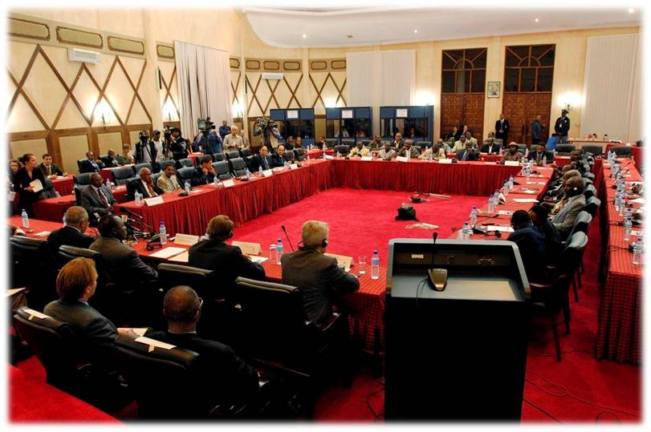
Basic Principle #1: Consent
All UN peacekeeping operations (UNPKOs) deploy at least with consent of the host authorities
UN Core Pre-Deployment Training Materials 2017

Slide 9
Consent: What Peacekeeping Personnel Can Do
Continuously scan and analyse environment
Learn about host country
Assess and report on parties
Build and respect trust
UN Core Pre-Deployment Training Materials 2017

Slide 10
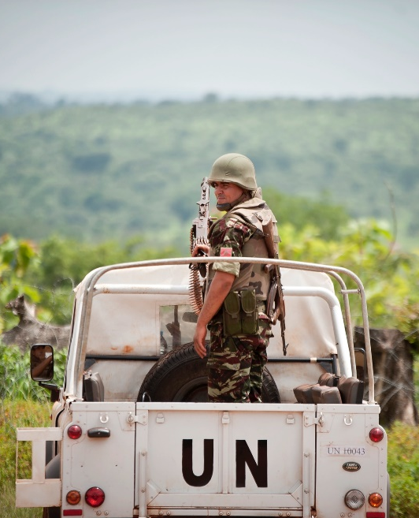
Basic Principle #2: Impartiality
UNPKOs implement mandates without favour or prejudice
UN Core Pre-Deployment Training Materials 2017

Slide 11
Impartiality: What Peacekeeping Personnel Can Do
Build relationships
Avoid activities compromising impartiality
Rationale for action well-established and communicated
Public information
communications and key
messages enforced
UN Core Pre-Deployment Training Materials 2017

Slide 12
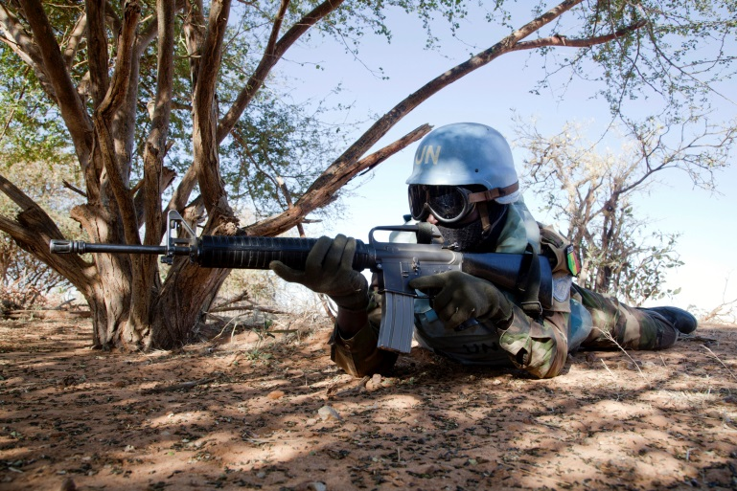
Basic Principle #3: Non-Use of Force Except in Self-Defence & Defence of the Mandate
Use of force permitted in self-defence and defence of mandate
Security Council authorizes “all necessary means” to defend the mandate
UN Core Pre-Deployment Training Materials 2017

Slide 13
Non-Use of Force: What Peacekeeping Personnel Can Do
Exercise restraint
Precise, proportional and appropriate use
Early de-escalation of violence, non-violent means of persuasion
Rules of Engagement (ROE) or Directive on Use of Force (DUF)
UN Core Pre-Deployment Training Materials 2017

Slide 14
2. Other Success Factors
Legitimacy
Credibility
Promotion of National and Local Ownership
UN Core Pre-Deployment Training Materials 2017

Slide 15
Learning Activity
1.3.3
Importance of Other Success Factors
Instructions:
Consider the case study
How did “legitimacy”, “credibility” and “national and local ownership” contribute to success?
Time: 5 minutes
Discussion: 3 minutes
Wrap-up: 2 minutes
UN Core Pre-Deployment Training Materials 2017

Slide 16
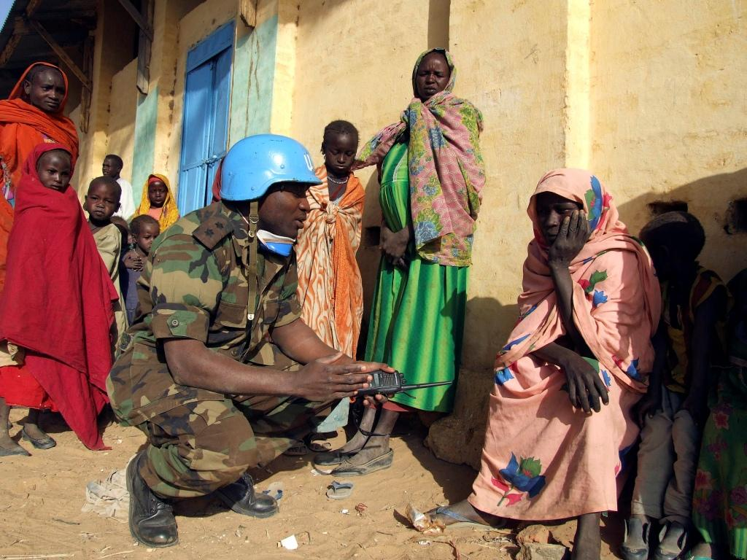
Success Factor #1: Legitimacy
UNPKOs have international legitimacy
Quality and conduct of personnel affect perceived legitimacy
UN Core Pre-Deployment Training Materials 2017

Slide 17
Legitimacy: What Peacekeeping Personnel Can Do
Maintain high standards of professionalism, competence, integrity
Respect local population
Zero tolerance for sexual exploitation and abuse
UN Core Pre-Deployment Training Materials 2017

Slide 18
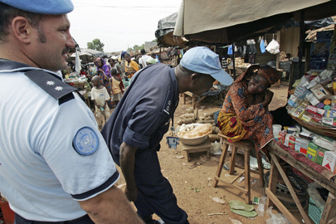
Success Factor #2: Credibility
Depends on achieving mandate
Affected by ability to manage and meet expectations
UN Core Pre-Deployment Training Materials 2017

Slide 19
Credibility: What Peacekeeping Personnel Can Do
Implement mandate
Remain confident, capable, unified
Manage expectations
UN Core Pre-Deployment Training Materials 2017

Slide 20
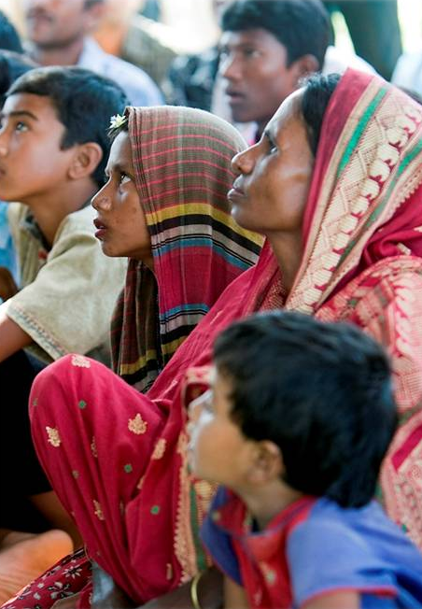
Success Factor #3: Promotion of National & Local Ownership
Inclusive and consultative processes
Include local and national perspectives
Allow national capacity to lead
UN Core Pre-Deployment Training Materials 2017

Slide 21
Promotion of National & Local Ownership: What Peacekeeping Personnel Can Do
Respect national sovereignty
Support and build national capacity
Build trust, cooperation
Be sensitive to local needs,
perspectives
UN Core Pre-Deployment Training Materials 2017

Slide 22
Summary of Key Messages
Basic principles – consent, impartiality, non-use of force except in self-defence and defence of the mandate
Key success factors – legitimacy, credibility, promotion of national and local ownership
“Legitimacy” – behaviour of highest standards
“Credibility” – implement mandate, manage expectations
“National and local ownership” – promote
UN Core Pre-Deployment Training Materials 2017

Slide 23
Questions
UN Core Pre-Deployment Training Materials 2017

Slide 24
Learning Activity
Learning Evaluation
UN Core Pre-Deployment Training Materials 2017

